Slide 1

RECAP
Topics Covered:
Cost Function
Gradient Descent
Derivatives
Implementation of logistic regression
AI4LE Week 3. Session 3

Slide 2
Today we will learn
Neural Network representation and architecture
Weight Initialisation and batch normalization
Activation Functions
Definition
Types of activation function
Optimisers
AI4LE Week 3. Session 3

Slide 3
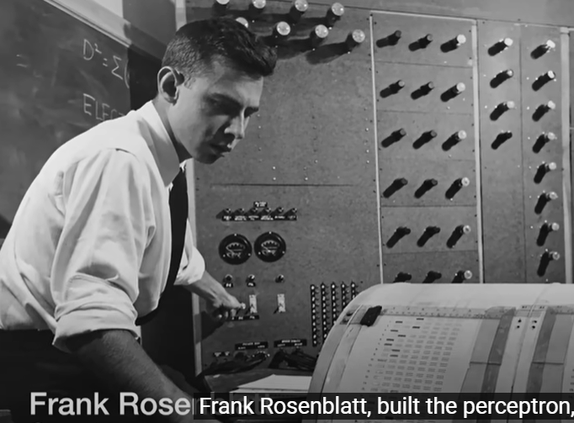
History of AI - year 1956
When a psychologist made perceptron
To mimic how neurons fire in our brain
AI4LE Week 3. Session 3

Slide 4
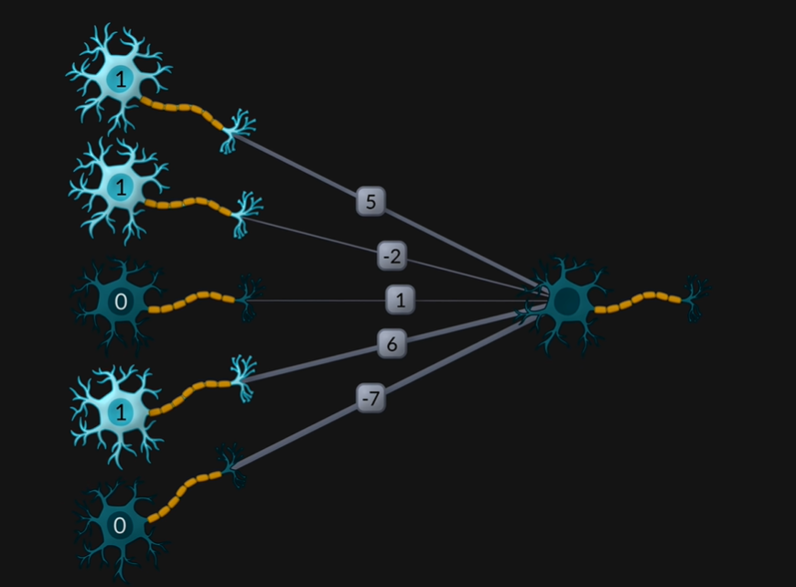
Similar to human brain in a neural network input of one neuron is actually the output of other neuron
AI4LE Week 3. Session 3

Slide 5
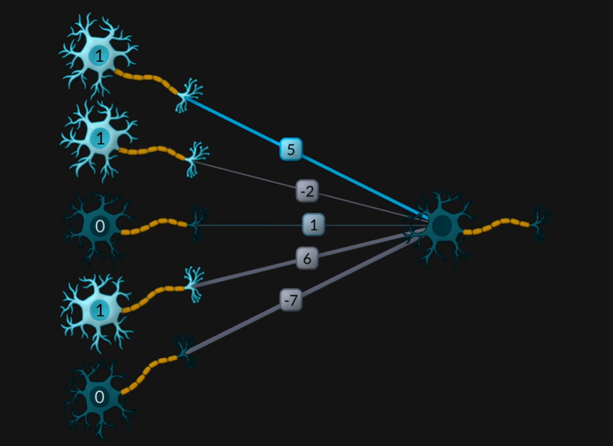
Each neuron also has a weight associated with the connection with other neuron
AI4LE Week 3. Session 3

Slide 6

If the sum of multiplication of neuron and connection weight > threshold the neuron fires or passes the information further
AI4LE Week 3. Session 3

Slide 7
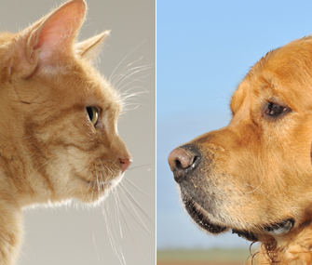
How a neural network works to decide if image is of dog or cat
AI4LE Week 3. Session 3

Slide 8

In general an image is arranged in a grid
AI4LE Week 3. Session 3

Slide 9
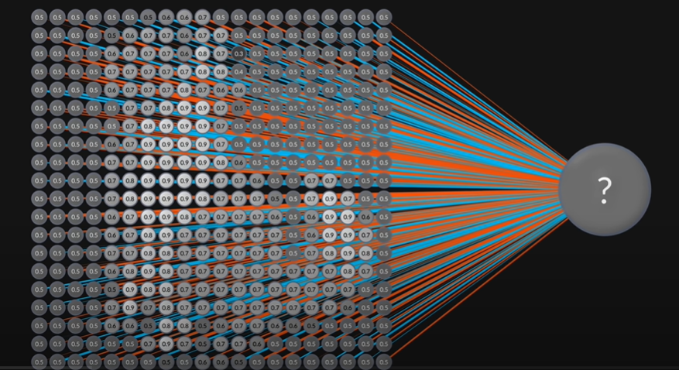
Each pixel can be considered as a neuron with its value (between 0 and 1), wrt intensity at that pixel, and all neurons are connected to single output neuron
AI4LE Week 3. Session 3

Slide 10
If the output (summation) > threshold then image belongs to class 1 else class 0
To achieve this the perceptron needs to be trained with training data images
Further, each pixel has its own weight, usually initialising with 0
This explains a single layer perceptron
AI4LE Week 3. Session 3

Slide 11
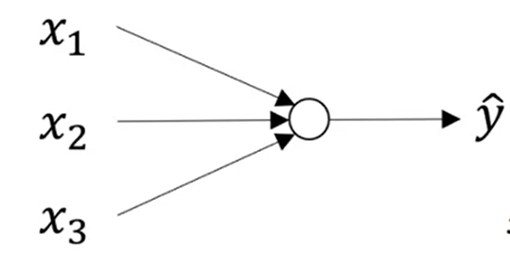
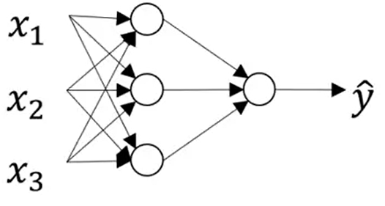
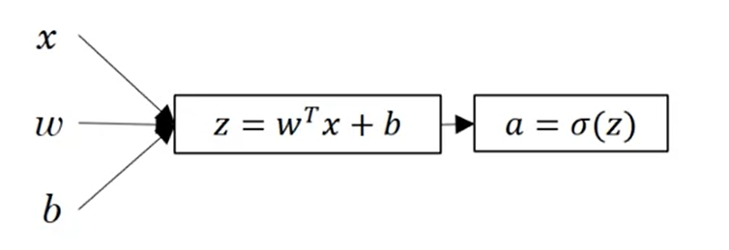
NEURAL NETWORK REPRESENTATION
AI4LE Week 3. Session 3

Slide 12
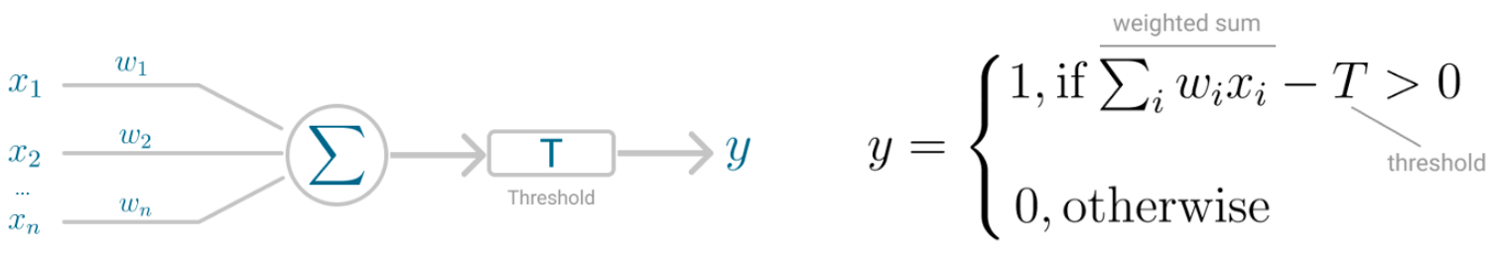
NEURAL NETWORK REPRESENTATION
Reference: Carolina Bento: https://towardsdatascience.com/multilayer-perceptron-explained-with-a-real-life-example-and-python-code-sentiment-analysis-cb408ee93141

Slide 13
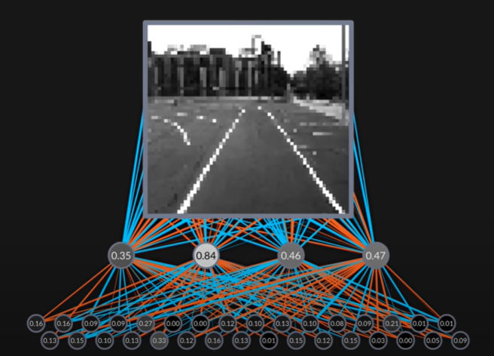
A multilayer perceptron looks something like this
AI4LE Week 3. Session 3

Slide 14
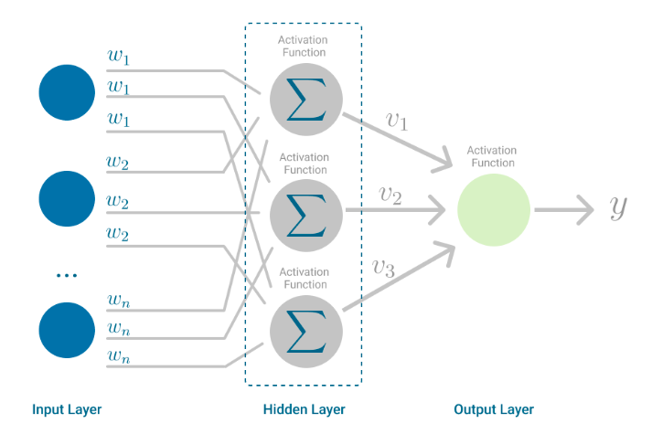
A multilayer perceptron looks something like this

Slide 15
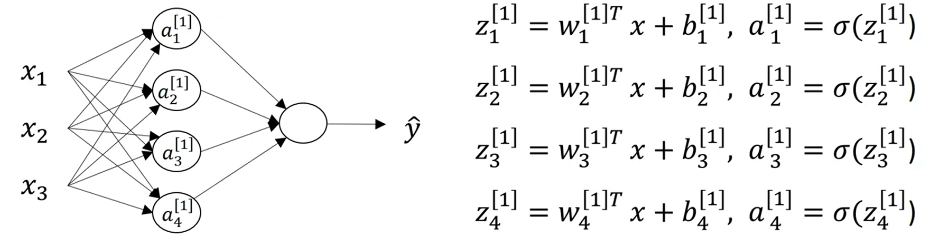
NEURAL NETWORK REPRESENTATION
AI4LE Week 3. Session 3

Slide 16
Properties of MLP
No connections within a layer
No direct connections between input and output layers
Fully connected between layers
Often more than 3 layers
Number of output units need not equal number of input units
Number of hidden units per layer can be more or less than
input or output units
Each unit is a perceptron
Often include bias as an extra weight
AI4LE Week 3. Session 3

Slide 17
To improve the neural network Batch Normalization is used
Before entering into Batch normalization let’s understand the term “Normalization”.
Normalization is a data pre-processing tool used to bring the numerical data to a common scale without distorting its shape.
Generally, when we input the data to a machine or deep learning algorithm we tend to change the values to a balanced scale. The reason we normalize is partly to ensure that our model can generalize appropriately.
AI4LE Week 3. Session 3

Slide 18
What is Batch Normalisation
Now coming back to Batch normalization, it is a process to make neural networks faster and more stable through adding extra layers in a deep neural network.
The new layer performs the standardizing and normalizing operations on the input of a layer coming from a previous layer.
AI4LE Week 3. Session 3

Slide 19
But what is the reason behind the term “Batch” in batch normalization?
A typical neural network is trained using a collected set of input data called batch.
Similarly, the normalizing process in batch normalization takes place in batches, not as a single input.
AI4LE Week 3. Session 3

Slide 20
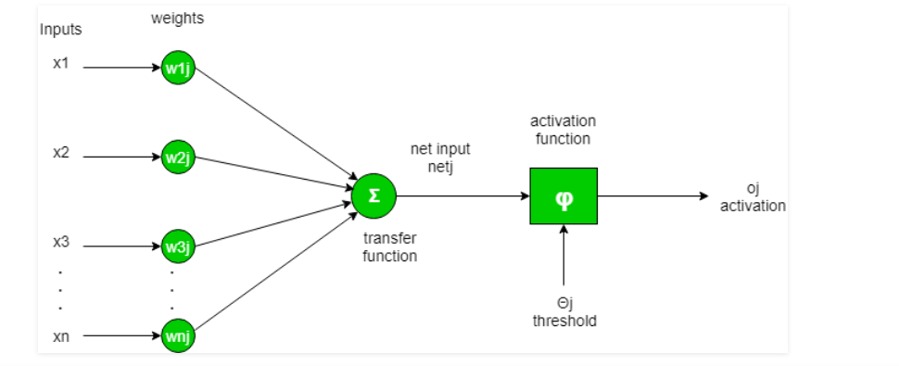
Activation function
To put in simple terms, an artificial neuron calculates the ‘weighted sum’ of its inputs and adds a bias, as shown in the figure below by the net input.
AI4LE Week 3. Session 3

Slide 21

Types of activation function
AI4LE Week 3. Session 3

Slide 22
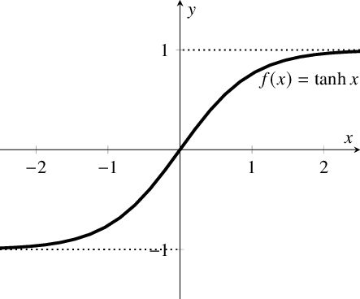
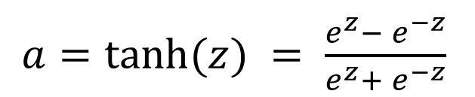
ACTIVATION FUNCTIONS
TanH
AI4LE Week 3. Session 3

Slide 23

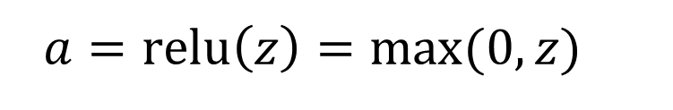
ACTIVATION FUNCTIONS
AI4LE Week 3. Session 3

Slide 24
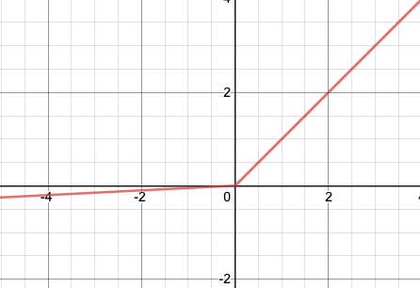
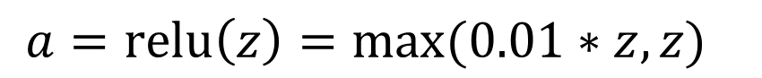
ACTIVATION FUNCTIONS
Leaky ReLU
AI4LE Week 3. Session 3

Slide 25
How do we improve MLP / NN
We use optimisation methods to arrive at the target or optimum weight value
AI4LE Week 3. Session 3

Slide 26
Gradient descent
The gradient descent method is the most popular optimisation method.
The idea of this method is to update the variables iteratively in the (opposite) direction of the gradients of the objective function.
With every update, this method guides the model to find the target and gradually converge to the optimal value of the objective function.
AI4LE Week 3. Session 3

Slide 27

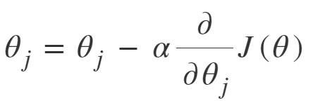
OPTIMIZERS
Stochastic Gradient Descent
AI4LE Week 3. Session 3

Slide 28
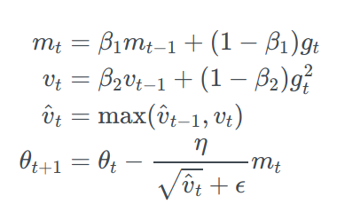
OPTIMIZERS
Adam
AI4LE Week 3. Session 3

Slide 29
Neural Networks: Feedforward and Backpropagation & Optimization
Neural networks consists of neurons, connections between these neurons called weights and some biases connected to each neuron.
We distinguish between input, hidden and output layers, where we hope each layer helps us towards solving our problem.
To move forward through the network, called a forward pass, we iteratively use a formula to calculate each neuron in the next layer.
This takes us forward, until we get an output.

Slide 30
Continued….
We measure how good this output, by a cost function and the result we wanted in the output layer
And we do this for every example
This one is commonly called mean squared error (MSE)

Slide 31
Continued…
Given the first result, we go back and adjust the weights and biases, so that we optimize the cost function — called a backwards pass.
We essentially try to adjust the whole neural network, so that the output value is optimized.
In a sense, this is how we tell the algorithm that it performed poorly or good.
We keep trying to optimize the cost function by running through new observations from our dataset.
To update the network, we calculate so called gradients, which is small nudges (updates) to individual weights in each layer.

Slide 32
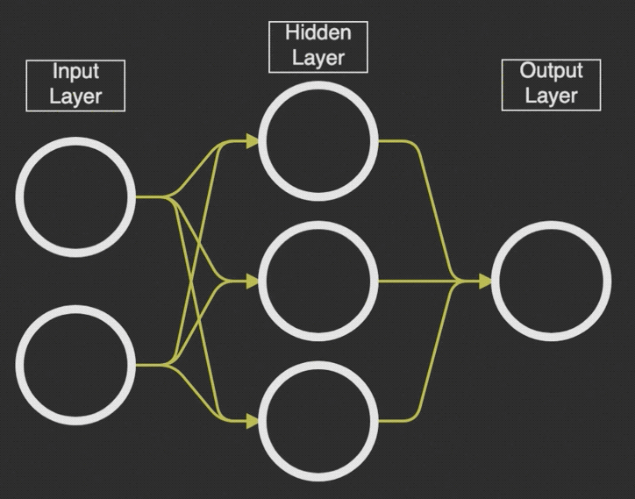
Step 1

Slide 33
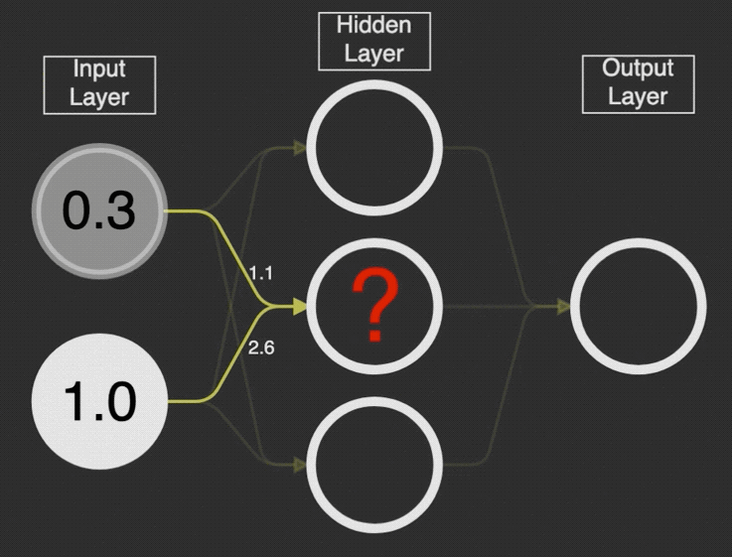
Step 2

Slide 34
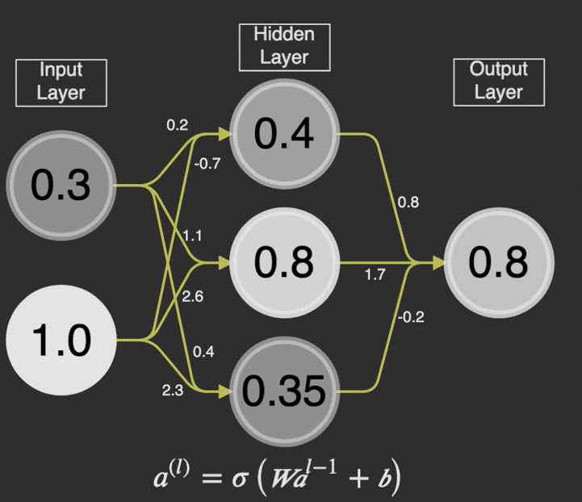
Step 3

Slide 35
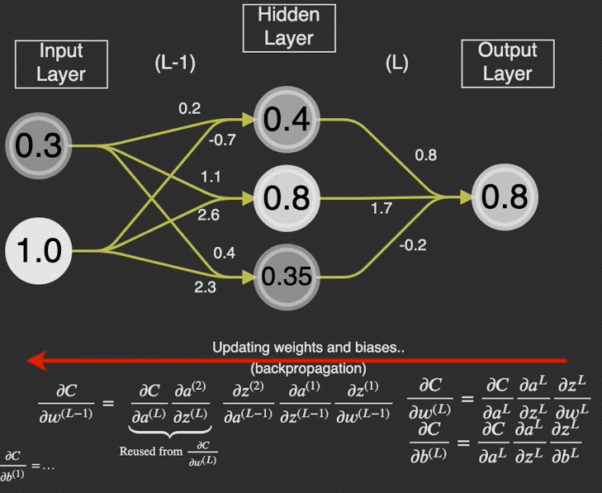
Step 4

Slide 36
References
https://towardsdatascience.com/multilayer-perceptron-explained-with-a-real-life-example-and-python-code-sentiment-analysis-cb408ee93141
https://www.ibm.com/in-en/cloud/learn/neural-networks#toc-how-do-neu-vMq6OP-P

Slide 37
NEXT Session
To be Covered:
Neural Network - Python Implementation on kaggle Notebook
AI4LE Week 3. Session 3

Slide 38
Time for some practice questions!
Q-1. What do you mean by perceptron? What are different types of perceptrons?
Q-2. When will neuron fires? What do you mean by threshold?
Consider threshold as 8, and input as 1,0,1,1,0 and respective associated weights as 2,9,5,6,3. In this scenario will the neuron passes information or not?
Q-3. What do mean by Normalization and how it is different from batch normalization?
Q-4 Why activation functions are used?
Q-5 Explain backpropagation in a NN setting.

